Slide 1
Lecture 7: Spatio-temporal models
May 8, 2018

Slide 2
Multiple ways to include interactions
Arises for whenever there’s multiple factors
Include spatial effect (No / Yes)
Include temporal effect (No / Independent / Smoothed)
Include spatio-temporal effect (No / Independent / Smoothed)

Slide 3
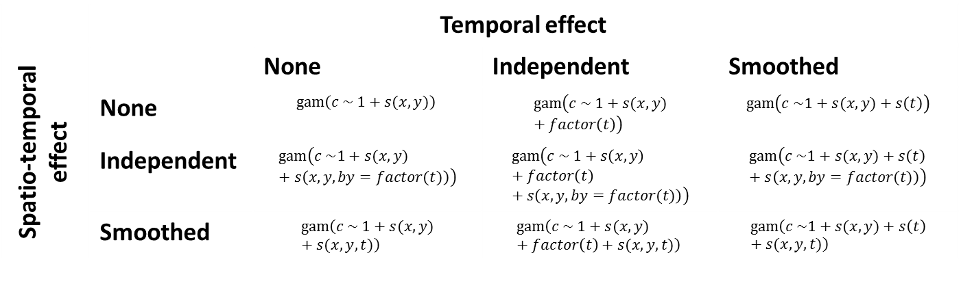
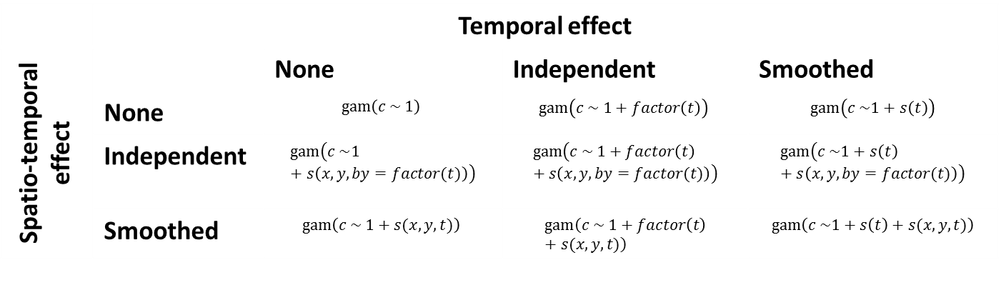
Without spatial
With spatial
 | Temporal effect
Spatio-temporal effect |  | None | Independent | Smoothed
 | None | $$gam\left(c \sim 1\right)$$ | $$gam\left(c \sim 1+factor\left(t\right)\right)$$ | $$gam\left(c \sim 1+s\left(t\right)\right)$$
 | Independent | $$gam\left(c \sim 1+s\left(x, y,by=factor(t)\right)\right)$$ | $$gam\left(c \sim 1+factor\left(t\right)+s\left(x, y,by=factor(t)\right)\right)$$ | $$gam\left(c \sim 1+s\left(t\right)+s\left(x, y,by=factor(t)\right)\right)$$
 | Smoothed | $$gam\left(c \sim 1+s(x,y,t)\right)$$ | $$gam\left(c \sim 1+factor\left(t\right)+s(x,y,t)\right)$$ | $$gam\left(c \sim 1+s\left(t\right)+s(x,y,t)\right)$$
 | Temporal effect
Spatio-temporal effect |  | None | Independent | Smoothed
 | None | $$gam\left(c \sim 1+s(x,y)\right)$$ | $$gam\left(c \sim 1+s(x,y)+factor\left(t\right)\right)$$ | $$gam\left(c \sim 1+s(x,y)+s\left(t\right)\right)$$
 | Independent | $$gam\left(c \sim 1+s(x,y)+s\left(x, y,by=factor(t)\right)\right)$$ | $$gam\left(c \sim 1+s\left(x,y\right)+factor\left(t\right)+s\left(x, y,by=factor(t)\right)\right)$$ | $$gam\left(c \sim 1+s(x,y)+s\left(t\right)+s\left(x, y,by=factor(t)\right)\right)$$
 | Smoothed | $$gam\left(c \sim 1+s(x,y)+s(x,y,t)\right)$$ | $$gam\left(c \sim 1+s(x,y)+factor\left(t\right)+s(x,y,t)\right)$$ | $$gam\left(c \sim 1+s(x,y)+s\left(t\right)+s(x,y,t)\right)$$

Slide 4
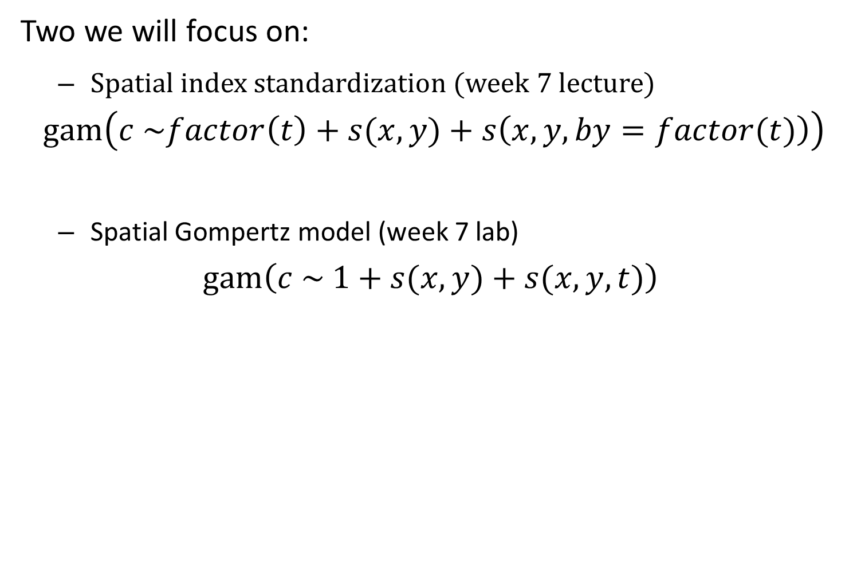
Two we will focus on:
Spatial index standardization (week 7 lecture)
$$gam\left(c \sim factor\left(t\right)+s(x,y)+s\left(x, y,by=factor(t)\right)\right)$$
Spatial Gompertz model (week 7 lab)
$$gam\left(c \sim 1+s(x,y)+s(x,y,t)\right)$$

Slide 5
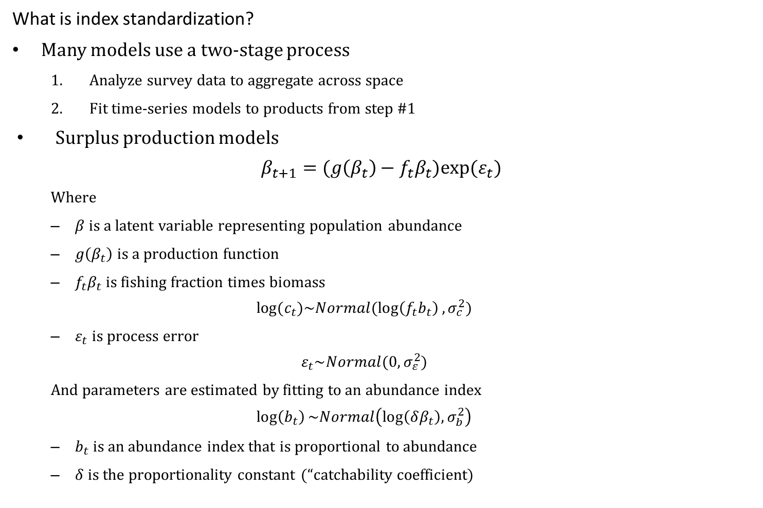
What is index standardization?
Many models use a two-stage process
Analyze survey data to aggregate across space
Fit time-series models to products from step #1
Surplus production models
$$β_{t+1}=(g\left(β_{t}\right)−f_{t}β_{t})exp⁡(ε_{t})$$
Where
$β$ is a latent variable representing population abundance
$g\left(β_{t}\right)$ is a production function
$f_{t}β_{t}$ is fishing fraction times biomass
$$log⁡(c_{t})\sim Normal(\log\left(f_{t}b_{t}\right),σ_{c}^{2})$$
$ε_{t}$ is process error
$$ε_{t}\sim Normal(0,σ_{ε}^{2})$$
And parameters are estimated by fitting to an abundance index
$$\log\left(b_{t}\right)\sim Normal\left(\log\left(δβ_{t}\right),σ_{b}^{2}\right)$$
$b_{t}$ is an abundance index that is proportional to abundance
$δ$ is the proportionality constant (“catchability coefficient)

Slide 6
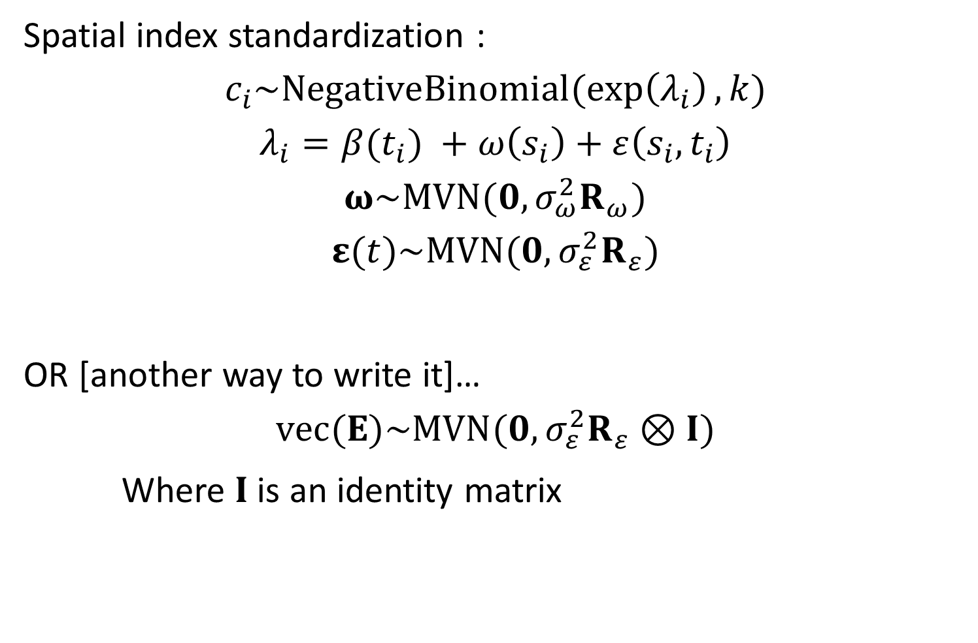
Spatial index standardization :
$$c_{i}\sim NegativeBinomial(\exp\left(λ_{i}\right),k)$$
$$λ_{i}=β(t_{i}) +ω\left(s_{i}\right)+ε\left(s_{i},t_{i}\right)$$
$$ω\sim MVN(0,σ_{ω}^{2}R_{ω})$$
$$ε(t)\sim MVN(0,σ_{ε}^{2}R_{ε})$$
OR [another way to write it]…
$$vec(Ε)\sim MVN(0,σ_{ε}^{2}R_{ε}⊗I)$$
Where $I$ is an identity matrix

Slide 7
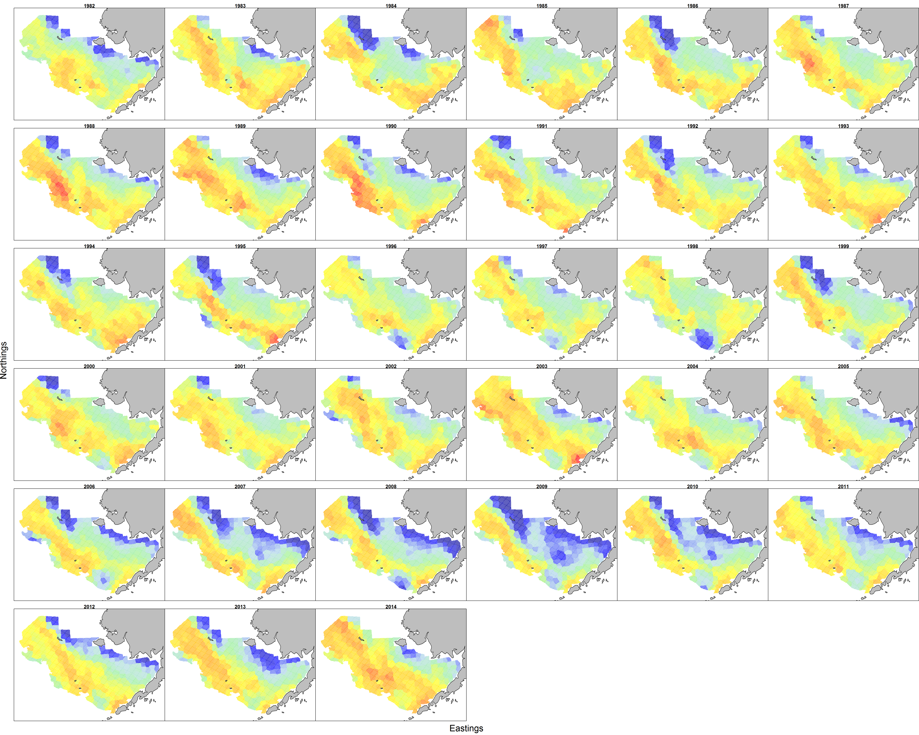
Two we will focus on:
Alaska pollock in the Eastern Bering Sea

Slide 8
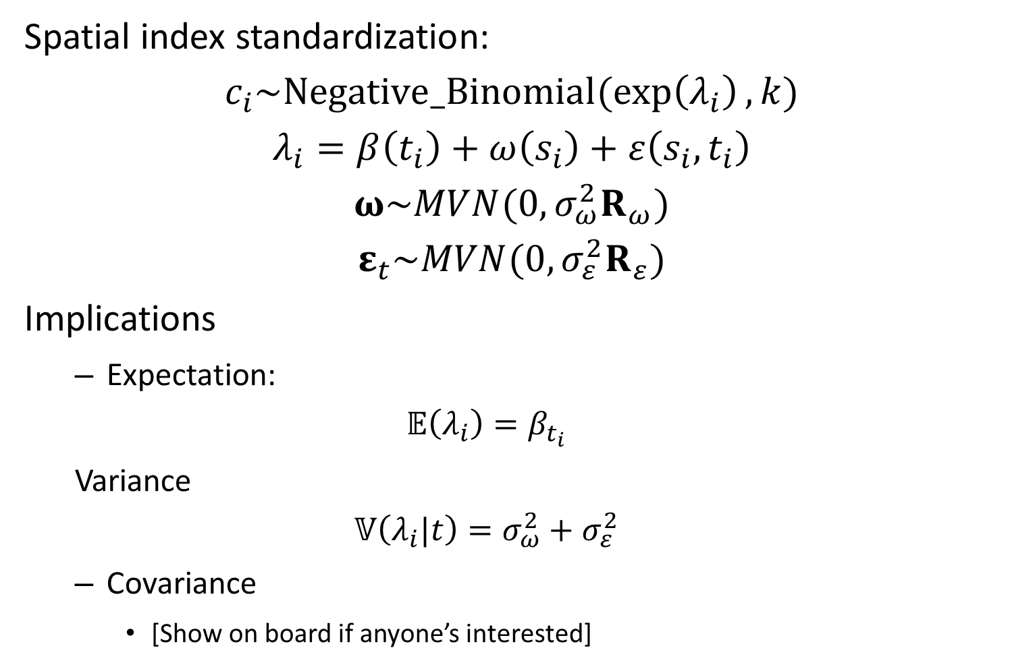
Spatial index standardization:
$$c_{i}\sim Negative_Binomial(\exp\left(λ_{i}\right),k)$$
$$λ_{i}=β\left(t_{i}\right)+ω\left(s_{i}\right)+ε\left(s_{i},t_{i}\right)$$
$$ω\sim MVN(0,σ_{ω}^{2}R_{ω})$$
$$ε_{t}\sim MVN(0,σ_{ε}^{2}R_{ε})$$
Implications
Expectation:
$$𝔼\left(λ_{i}\right)=β_{t_{i}}$$
Variance
$$𝕍\left(λ_{i}|t\right)=σ_{ω}^{2}+σ_{ε}^{2}$$
Covariance
[Show on board if anyone’s interested]

Slide 9
Ways to model survey data:
Discrete data
Counts
Often contains more zeros than expected (true and false zeros)
Continuous data
Biomass
Often arises from weighing all encountered individuals
Must model zeros (non-encounter) and positive real biomass

Slide 10
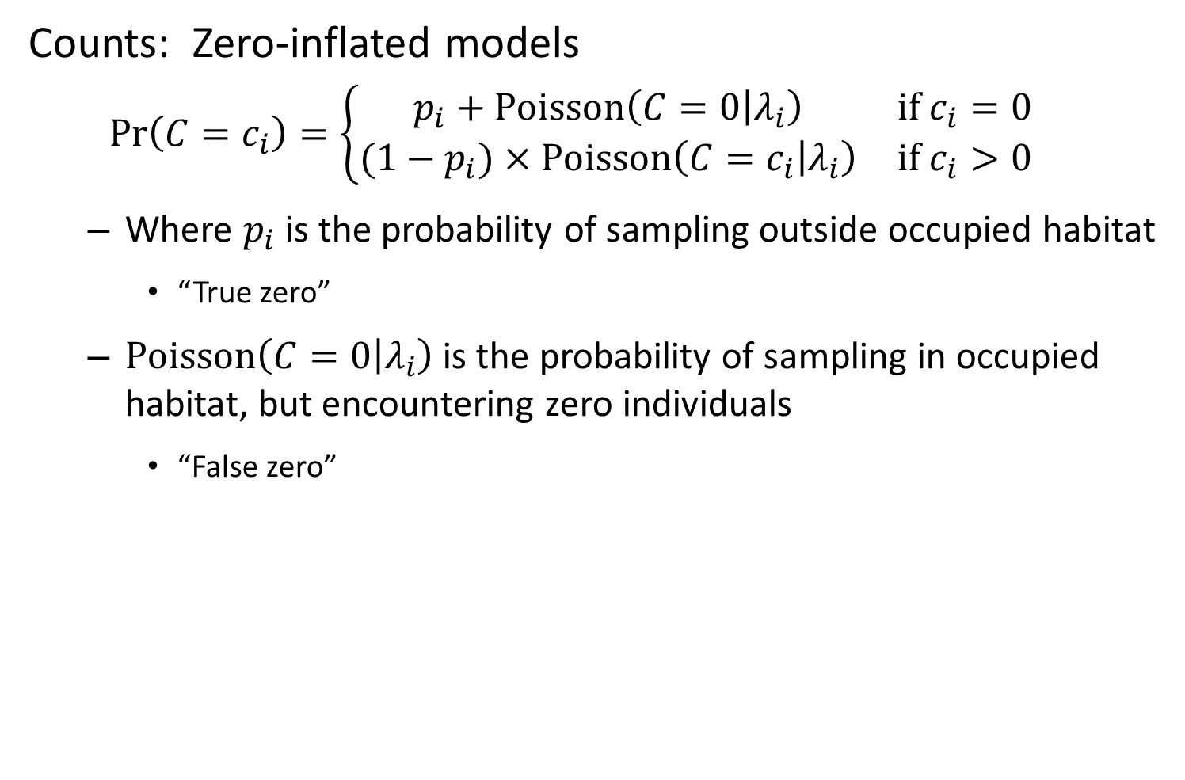
Counts: Zero-inflated models
$$\operatorname{Pr}\left(C=c_{i}\right)=\left\{\begin{matrix}p_{i}+Poisson\left(C=0 | λ_{i}\right) & if c_{i}=0 \\ (1−p_{i})×Poisson\left(C=c_{i} | λ_{i}\right) & if c_{i}>0\end{matrix}\right.$$
Where $p_{i}$ is the probability of sampling outside occupied habitat
“True zero”
$Poisson\left(C=0 | λ_{i}\right)$ is the probability of sampling in occupied habitat, but encountering zero individuals
“False zero”

Slide 11
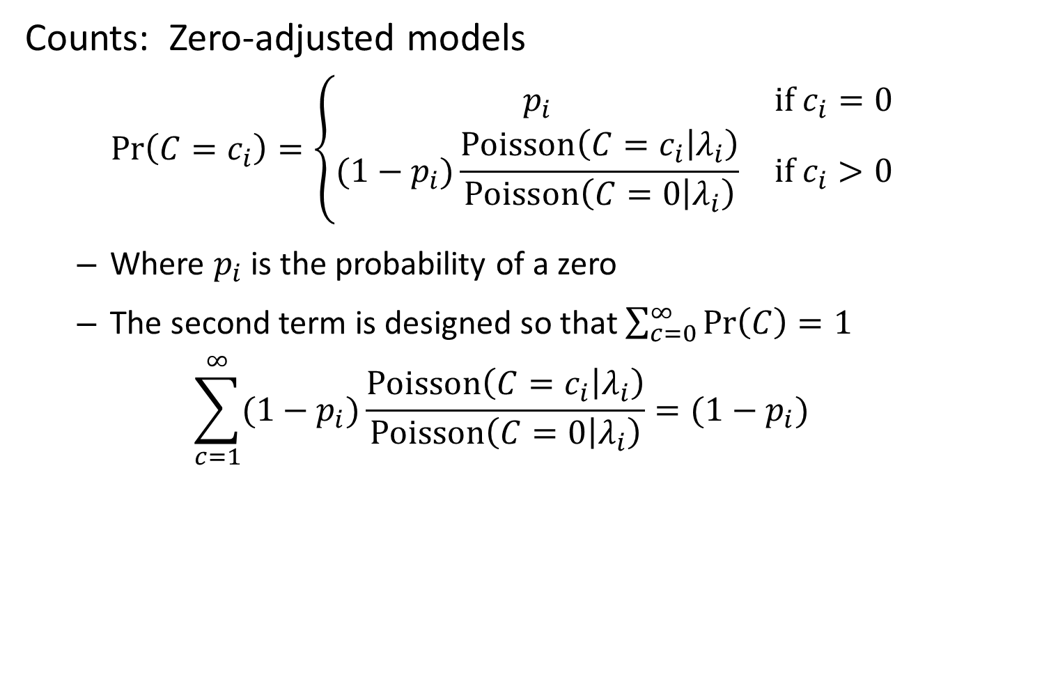
Counts: Zero-adjusted models
$$\operatorname{Pr}\left(C=c_{i}\right)=\left\{\begin{matrix}p_{i} & if c_{i}=0 \\ (1−p_{i})\frac{Poisson\left(C=c_{i} | λ_{i}\right)}{Poisson\left(C=0 | λ_{i}\right)} & if c_{i}>0\end{matrix}\right.$$
Where $p_{i}$ is the probability of a zero
The second term is designed so that $\sum_{c=0}^{∞}{\operatorname{Pr}\left(C\right)=1}$
$$\sum_{c=1}^{∞}{(1−p_{i})\frac{Poisson\left(C=c_{i} | λ_{i}\right)}{Poisson\left(C=0 | λ_{i}\right)}}=(1−p_{i})$$

Slide 12
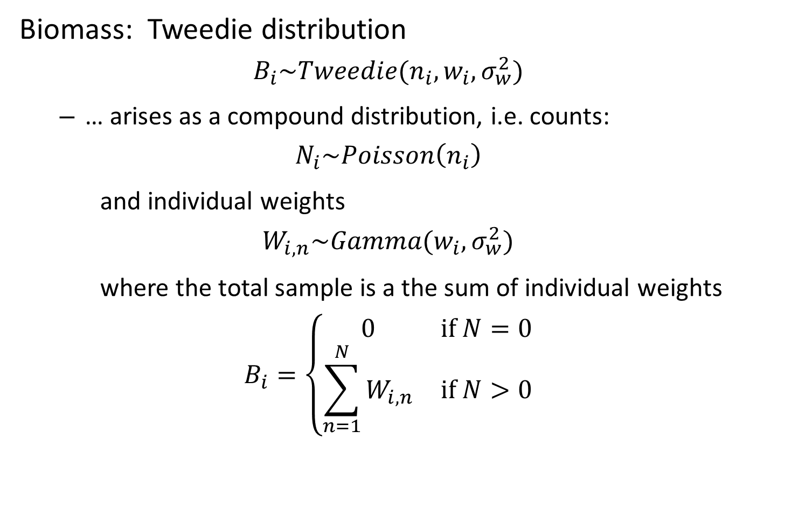
Biomass: Tweedie distribution
$$B_{i}\sim Tweedie(n_{i},w_{i},σ_{w}^{2})$$
… arises as a compound distribution, i.e. counts:
$$N_{i}\sim Poisson\left(n_{i}\right)$$
and individual weights
$$W_{i,n}\sim Gamma(w_{i},σ_{w}^{2})$$
where the total sample is a the sum of individual weights
$$B_{i}=\left\{\begin{matrix}0 & if N=0 \\ \sum_{n=1}^{N}{W_{i,n}} & if N>0\end{matrix}\right.$$

Slide 13
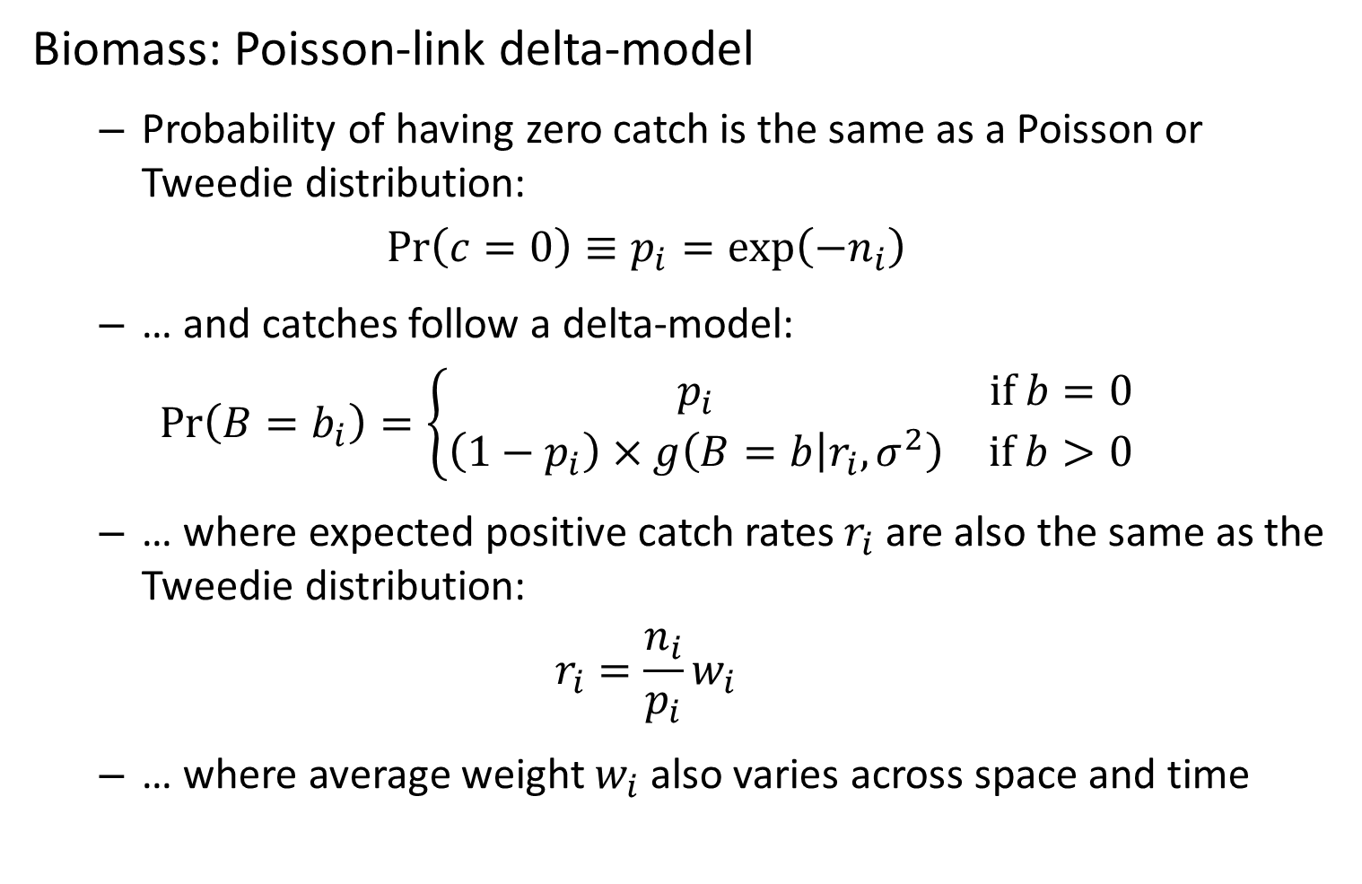
Biomass: Poisson-link delta-model
Probability of having zero catch is the same as a Poisson or Tweedie distribution:
$$\operatorname{Pr}\left(c=0\right)≡p_{i}=\exp\left(−n_{i}\right)$$
… and catches follow a delta-model:
$$\operatorname{Pr}\left(B=b_{i}\right)=\left\{\begin{matrix}p_{i} & if b=0 \\ \left(1−p_{i}\right)×g\left(B=b | r_{i},σ^{2}\right) & if b>0\end{matrix}\right.$$
… where expected positive catch rates $r_{i}$ are also the same as the Tweedie distribution:
$$r_{i}=\frac{n_{i}}{p_{i}}w_{i}$$
… where average weight $w_{i}$ also varies across space and time

Slide 14
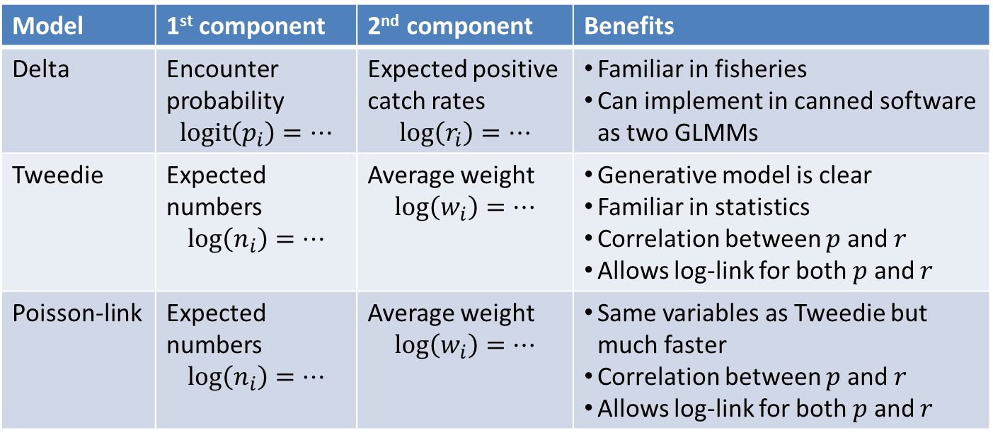
Biomass: Comparison of Tweedie, delta, and Poisson-link models
Model | 1st component | 2nd component | Benefits
Delta | Encounter probability $$\operatorname{logit}\left(p_{i}\right)=…$$ | Expected positive catch rates $$log\left(r_{i}\right)=…$$ | Familiar in fisheries Can implement in canned software as two GLMMs
Tweedie | Expected numbers $$\log\left(n_{i}\right)=…$$ | Average weight $$\log\left(w_{i}\right)=…$$ | Generative model is clear Familiar in statistics Correlation between $p$ and $r$ Allows log-link for both $p$ and $r$
Poisson-link | Expected numbers $$\log\left(n_{i}\right)=…$$ | Average weight $$\log\left(w_{i}\right)=…$$ | Same variables as Tweedie but much faster Correlation between $p$ and $r$ Allows log-link for both $p$ and $r$

Slide 15
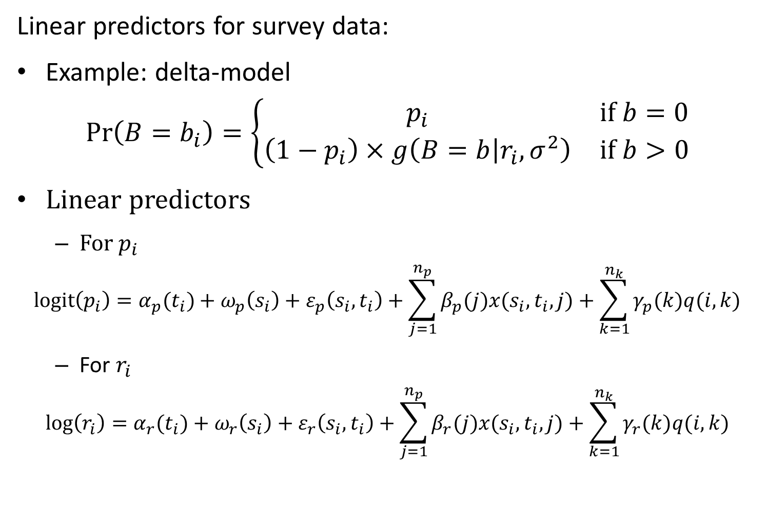
Linear predictors for survey data:
Example: delta-model
$$\operatorname{Pr}\left(B=b_{i}\right)=\left\{\begin{matrix}p_{i} & if b=0 \\ \left(1−p_{i}\right)×g\left(B=b | r_{i},σ^{2}\right) & if b>0\end{matrix}\right.$$
Linear predictors
For $p_{i}$
$$logit\left(p_{i}\right)=α_{p}(t_{i})+ω_{p}\left(s_{i}\right)+ε_{p}\left(s_{i},t_{i}\right)+\sum_{j=1}^{n_{p}}{β_{p}(j)x(s_{i},t_{i},j)}+\sum_{k=1}^{n_{k}}{γ_{p}(k)q(i,k)}$$
For $r_{i}$
$$log\left(r_{i}\right)=α_{r}(t_{i})+ω_{r}\left(s_{i}\right)+ε_{r}\left(s_{i},t_{i}\right)+\sum_{j=1}^{n_{p}}{β_{r}(j)x(s_{i},t_{i},j)}+\sum_{k=1}^{n_{k}}{γ_{r}(k)q(i,k)}$$

Slide 16
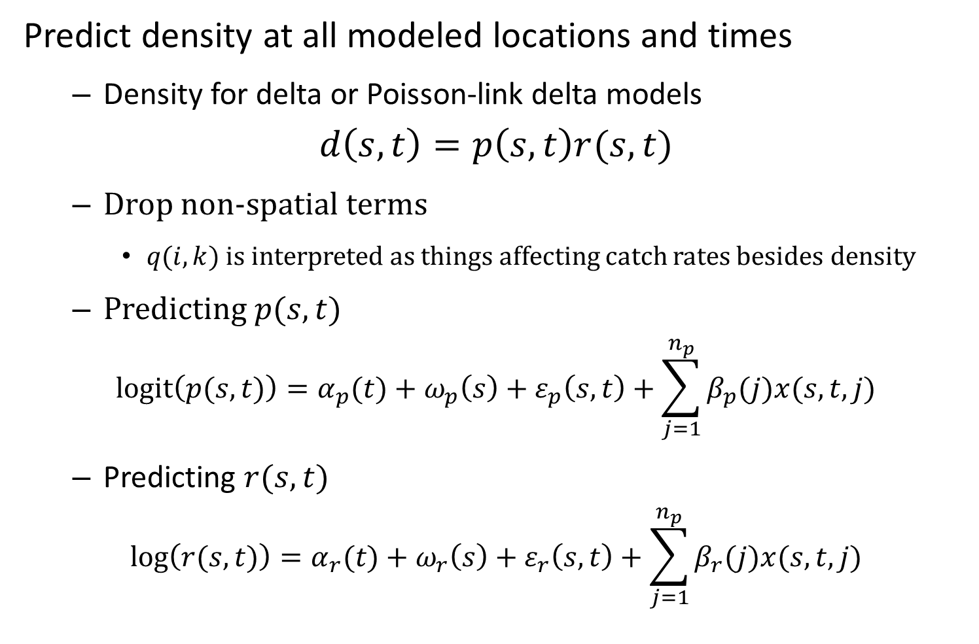
Predict density at all modeled locations and times
Density for delta or Poisson-link delta models
$$d\left(s,t\right)=p\left(s,t\right)r(s,t)$$
Drop non-spatial terms
$q(i,k)$ is interpreted as things affecting catch rates besides density
Predicting $p(s,t)$
$$logit\left(p(s,t)\right)=α_{p}(t)+ω_{p}\left(s\right)+ε_{p}\left(s,t\right)+\sum_{j=1}^{n_{p}}{β_{p}(j)x(s,t,j)}$$
Predicting $r(s,t)$
$$log\left(r(s,t)\right)=α_{r}(t)+ω_{r}\left(s\right)+ε_{r}\left(s,t\right)+\sum_{j=1}^{n_{p}}{β_{r}(j)x(s,t,j)}$$

Slide 17
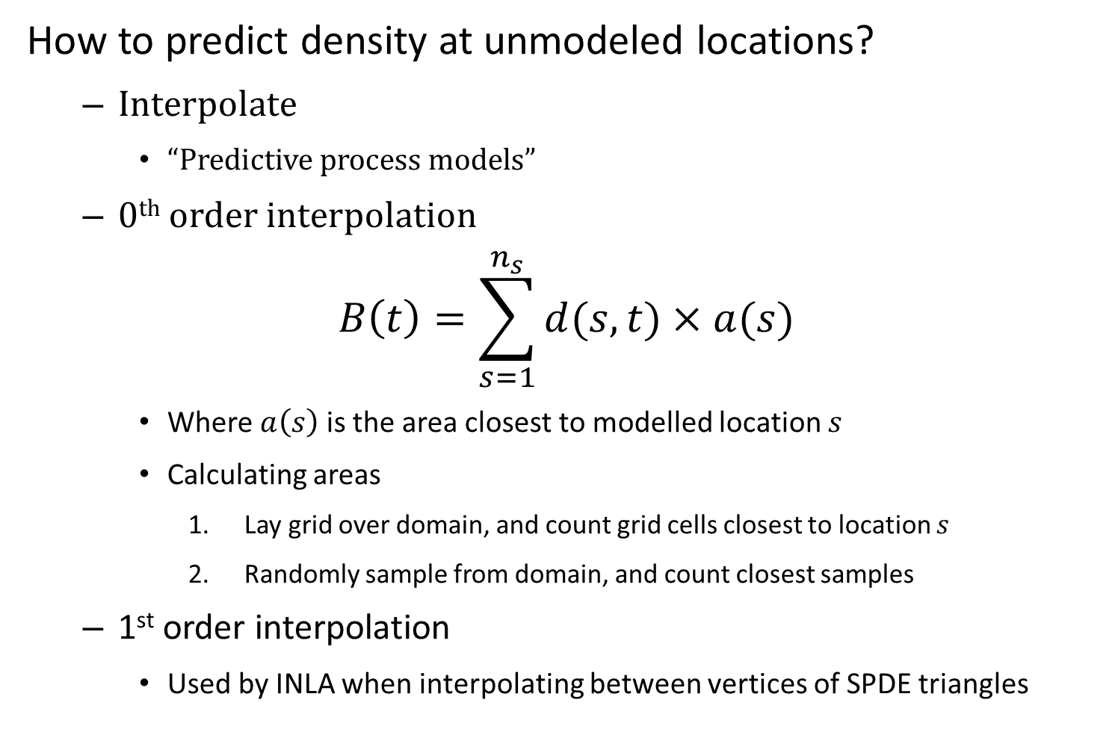
How to predict density at unmodeled locations?
Interpolate
“Predictive process models”
0th order interpolation
$$B\left(t\right)=\sum_{s=1}^{n_{s}}{d(s,t)×a(s)}$$
Where $a\left(s\right)$ is the area closest to modelled location $s$
Calculating areas
Lay grid over domain, and count grid cells closest to location $s$
Randomly sample from domain, and count closest samples
1st order interpolation
Used by INLA when interpolating between vertices of SPDE triangles

Slide 18
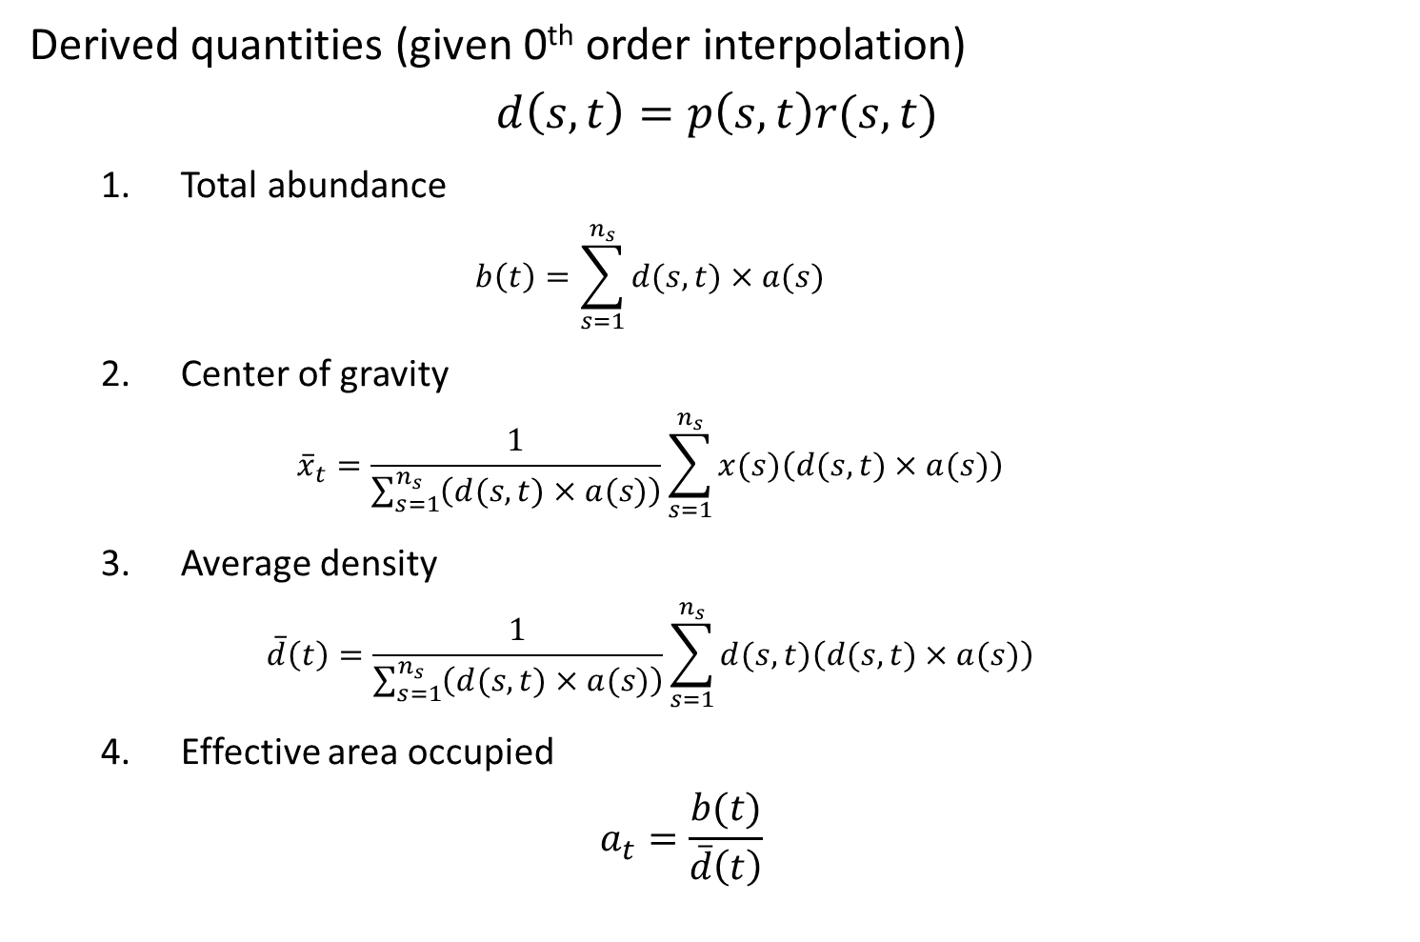
Derived quantities (given 0th order interpolation)
$$d\left(s,t\right)=p\left(s,t\right)r(s,t)$$
Total abundance
$$b\left(t\right)=\sum_{s=1}^{n_{s}}{d(s,t)×a(s)}$$
Center of gravity
$${\overline{x}}_{t}=\frac{1}{\sum_{s=1}^{n_{s}}{\left(d(s,t)×a(s)\right)}}\sum_{s=1}^{n_{s}}{x(s)\left(d(s,t)×a(s)\right)}$$
Average density
$$\overline{d}\left(t\right)=\frac{1}{\sum_{s=1}^{n_{s}}{\left(d(s,t)×a(s)\right)}}\sum_{s=1}^{n_{s}}{d(s,t)\left(d(s,t)×a(s)\right)}$$
Effective area occupied
$$a_{t}=\frac{b(t)}{\overline{d}\left(t\right)}$$

Slide 19
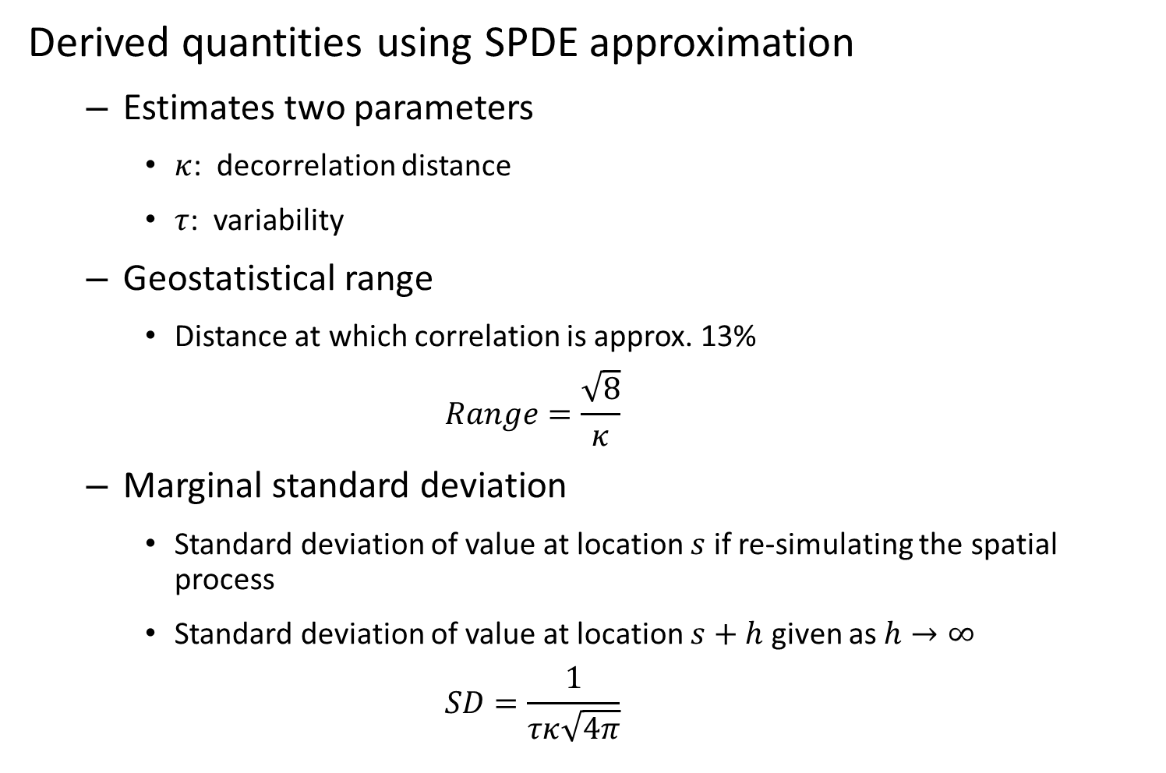
Derived quantities using SPDE approximation
Estimates two parameters
$κ$: decorrelation distance
$τ$: variability
Geostatistical range
Distance at which correlation is approx. 13%
$$Range=\frac{\sqrt{8}}{κ}$$
Marginal standard deviation
Standard deviation of value at location $s$ if re-simulating the spatial process
Standard deviation of value at location $s+h$ given as $h→∞$
$$SD=\frac{1}{τκ\sqrt{4π}}$$

Slide 20
Exercise
Divide into groups and add center-of-gravity, average density, and effective area occupied calculations

